Slide 1
C++ LOOP Optimisations
By
Ryan Westwood

Slide 2
What’s this talk about?
Memory layout
Cache awareness
Compiler explorer
Benchmarking
Notes:
When it comes to looping it’s important to know what data you’re looping over and how the machine will interpret this data. Lastly some benchmarks showing some real results on how each approach will look from a performance perspective.

Slide 3
Buzz words – Quick overview
Cache line
Loop unrolling
Vectorization
SIMD
Prefetcher
Padding
Notes:
A cacheline simply put is how the CPU retrieves data from System Memory, this can vary depending on the architecture in use so it’s best to query this in advance. Typically, 64 Bytes on consumer desktops x64.
Loop unrolling is the idea of doing multiple things inside 1 loop iteration to reduce loops and their memory access times.
Prefetchers won’t be discussed in this talk but it’s useful to know of, CPUs are good at patterns making it possible for them to fetch data into cache before needing to access.
Vectorization is the idea of parallelising a loop.
SIMD instructions allow the CPU to perform single instructions on multiple data, this can significantly performance
Padding is how much memory a data type can add in order to keep memory alignments

Slide 4
What’s wrong with this code?
Figure 1: Case A
Notes:
The indexing!

Slide 5
What does this mean?
Indexing:
0, 10, 20, 30, 40, 50, 60, 70, 80, 90, 1, 11, 21, 31, 41, 51, 61, 71, etc…
Notes:
We know memory is contiguous, so jumping around indexes like this is a lot of work for the CPU.

Slide 6
What does this mean?
Benchmark Result: 0.852ms
= Vector2 (8 Bytes)
N = Index
0
1
2
3
4
5
6
7
8
9
10
11
12
13
14
15
Cache line (64 Bytes)
Notes:
What does this code look like on a CPU level?
The CPU calls the data required from system memory, and you’d expect naively that the CPU would pull Vector 2 from memory which is 8 bytes and only 8bytes. However, the lowest amount a CPU can pull is a cache line which in this case is 64 bytes, these 64 bytes now live in cache! So, we effectively have 8 useful bytes and the next 56 bytes which in this instance aren’t being used taking up space in cache. This resulted in this approach taking 0.852ms

Slide 7
How can we improve this?
Figure 2: Case B
Notes:
Indexing again!

Slide 8
That’s an improvement
Indexing:
0, 1, 2, 3, 4, 5, 6, 7, 8, 9, 10, 11, 12, 13, 14, 15, 16, 17, 18, 19, 20, etc…

Slide 9
That’s an improvement
Benchmark Result: 0.525ms
= Vector2 (8 Bytes)
0
1
2
3
4
5
6
7
8
9
10
11
12
13
14
15
Cache line (64 Bytes)
Notes:
Notice this time we’re making use of the data that was already fetched with the initial cachline. This makes accessing contiguous elements a lot faster as fetching from memory is slow. This resulted in a big performance gain now being 0.525ms

Slide 10
More?
Benchmark Result: 0.481ms
Figure 3: Case C
Notes:
What makes this faster?
Same memory layout as Case B, however storing the index calculation saves the CPU from repeating the same calculation multiple times. A simple change yet it makes a meaningful improvement performance wise. Yet another performance win now only taking 0.481ms

Slide 11
MORE???
Benchmark Result: 0.477ms
Figure 4: Case D
Notes:
What makes this faster?
This comes down to how the loops are compiled. Iterators vs Indexes
A,B and C used index.
D uses iterators
May vary depending on compiler and optimisation levels based on benchmarks this can perform within margin of error with case C. This isn’t necessarily a performance win because it’s too close to Case C but I prefer the readability over indexed loops so that’s nice.

Slide 12
Magic!!!
Figure 5: Case E
Notes:
What makes this faster?
This is a more advanced use of the memory layout of the program. What makes this different to the initial loop attempts? Loop unrolling this an advancement on case B
The first change 2 loops have been turned into 1 and index is now the loop variable saving calculations.
The is that there’s 2 loops. Which will be explained next slide.

Slide 13
How does this Work?
Benchmark Result: 0.240ms
= Vector2 (8 Bytes)
N = Index
0
1
2
3
4
5
6
7
8
9
10
11
12
13
14
15
Cache line (64 Bytes)
Notes:
This function works very similar to case B with 1 crucial difference. It implements loop unrolling. It loads a cache line which is 64 bytes and addresses all 64 bytes then proceeds to the next loop. This is a huge increase!!! However, you’ll notice in the implementation there's 2 loops. This is because if your vector of values in this case isn’t divisible by 8 because (cacheline / vector2) = 8 it’ll try to access uninitialized memory. So the first loop deals with assigning the bulk of data and the secondary loop is responsible for cleaning the few elements that are the remainder of the division. This was a huge win for performance now only taking 0.24ms to complete the same task!! 3.55x faster than the initial implementations

Slide 14
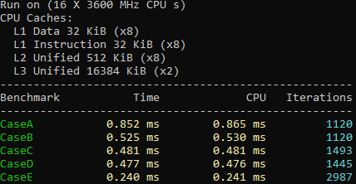
Benchmarks
Figure 6: Results
Notes:
It its important to remember when working with hardware this closely you need to be informed on compiler flags, compiler optimisations, hardware level knowledge e.g. cacheline sizes, data type sizes.

Slide 15
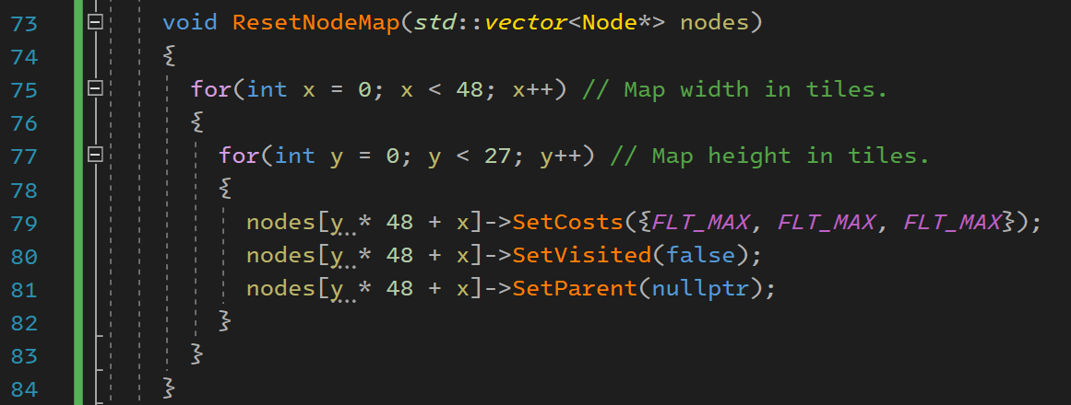
Real-world example
Figure 7: Non-contiguous looping
Notes:
In this example, I’m trying to reset a grid for pathfinding. I realised this had the same issue as Case A so I used the Case B approach and realised that hard coding values for the width and height wouldn’t matter if I used foreach loops on the vector. Opting for Case D’s approach

Slide 16
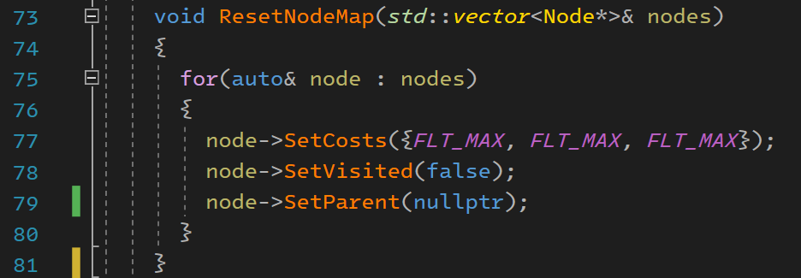
Real-world example
Figure 8: Case D implementation in a real project

Slide 17
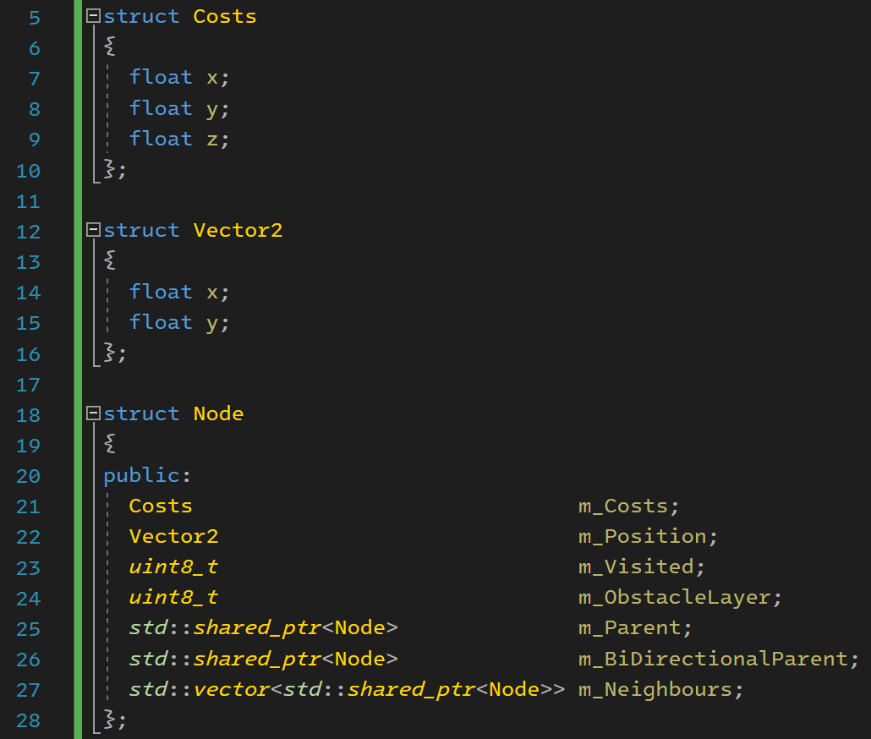
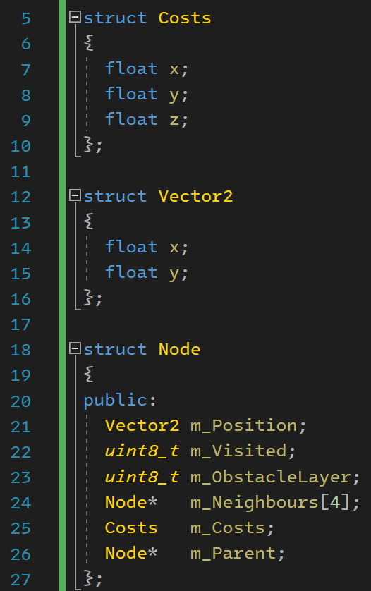
Real-world example
Figure 9: Node Implementation 1
Figure 10: Node Implementation 2
Notes:
With the idea of wanting a more cache friendly A* algorithm I investigated how the algo interacted with cache lines. Will this affect performance? Nope,
Implementation 1 is 80 bytes
Implementation 2 is 72 bytes by removing shared_ptrs and vector. This is due to those data type using internal bookkeeping.
So neither of these approaches would interact too differently as they would both require 2 cache lines. However, I realised that something wasn’t adding up. 8 + 1 + 1 + 32 + 12 + 8 = 62 not 72. What’s going on? PADDING!!

Slide 18
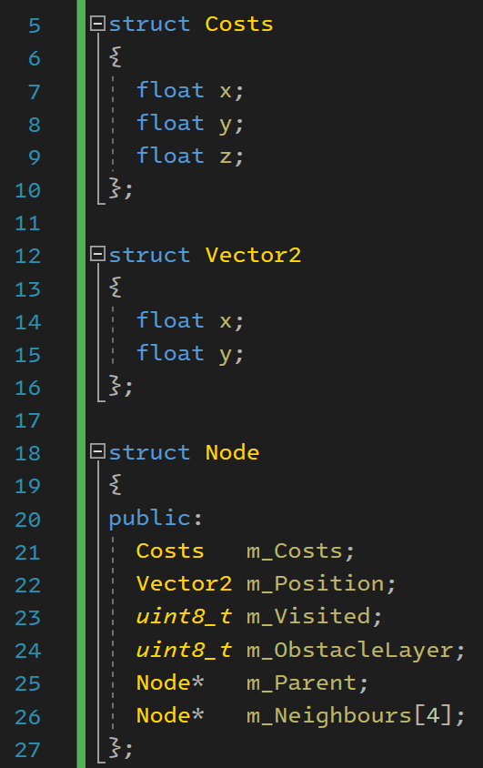
Real-world example
Figure 11: Node Implementation 3
Notes:
By rearranging the memory layout of the node, I managed to reduce the padding from 72 bytes down to 64 bytes. BINGO!!! It still has 2 bytes of memory that are used for memory alignment, but the node can now fit on a single cache line. This resulted in a big increase in performance

Slide 19
Questions?

Slide 20
References
Case A: https://godbolt.org/z/e6Mj9evrP
Case B: https://godbolt.org/z/Mxfzxj1WY
Case C: https://godbolt.org/z/frnnW3cWz
Case D: https://godbolt.org/z/3x8ec6MWe
Case E: https://godbolt.org/z/vGK7M134W
AI Library: https://github.com/RyanWestwood/AI-Library/tree/main

